Slide 1

The Quantum Computing Revolution
Quantum computing promises to unlock a new frontier of computational power, with the potential to transform fields ranging from cryptography to drug discovery. This presentation will explore the fundamental principles, current capabilities, and future impact of this revolutionary technology.
By Harshitha E (22071A6775)

Slide 2

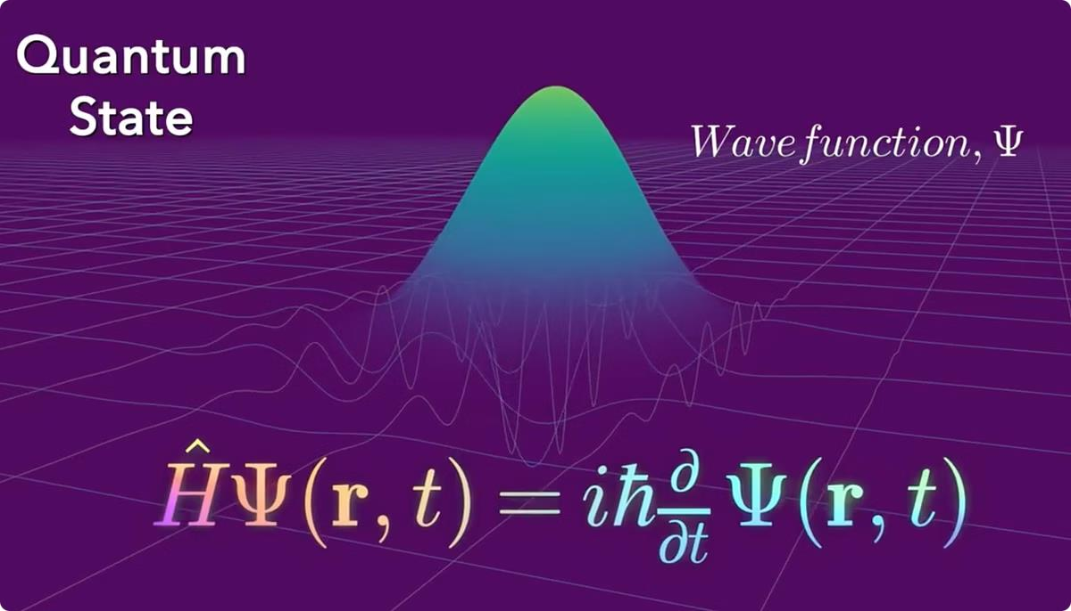
What is Quantum Computing?
1
Harnessing Quantum Mechanics
Quantum computers leverage the strange behaviors of subatomic particles, such as superposition and entanglement, to perform computations.
Novel Algorithms
2
Exponential Processing Power
Quantum bits, or qubits, can represent multiple states simultaneously, enabling quantum computers to tackle problems that are intractable for classical computers.
3
Quantum algorithms, like Shor's algorithm for factoring large numbers, can solve certain problems much faster than classical algorithms.

Slide 3
The Principles of Quantum Mechanics
Uncertainty Principle
Superposition
Entanglement
The fundamental limitation that the more precisely the position of a particle is determined, the less precisely its momentum can be known.
The ability of a quantum system to exist in multiple states simultaneously, before measurement forces it into a single state.
The phenomenon where two or more quantum particles become inextricably linked, such that the state of one particle depends on the state of the others.

Slide 4

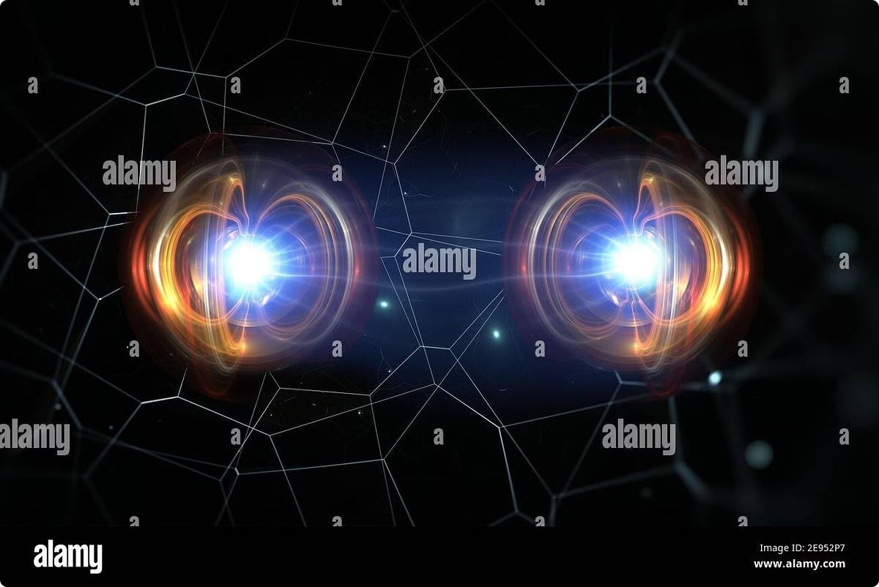
S uperposition and Entanglement
1
Superposition
Quantum particles can exist in a superposition of multiple states,
rather than being limited to a single definite state.
2
Entanglement
Entangled particles exhibit a strong, non-classical correlation, where the state of one particle depends on the state of the others.
3
Measurement
Observing or measuring a quantum system causes it to collapse
into a single, definite state, destroying the superposition.

Slide 5
Qubit vs. Classical Bit
Classical Bit
Quantum Bit (Qubit)
Exponential Potential
A classical bit can only exist in a definite state of 0 or 1, representing the basic unit of information in classical computing.
A qubit can exist in a superposition of 0 and 1, allowing it to represent more information than a classical bit.
With n qubits, a quantum computer can represent 2^ n possible states simultaneously, offering exponential performance advantages.

Slide 6

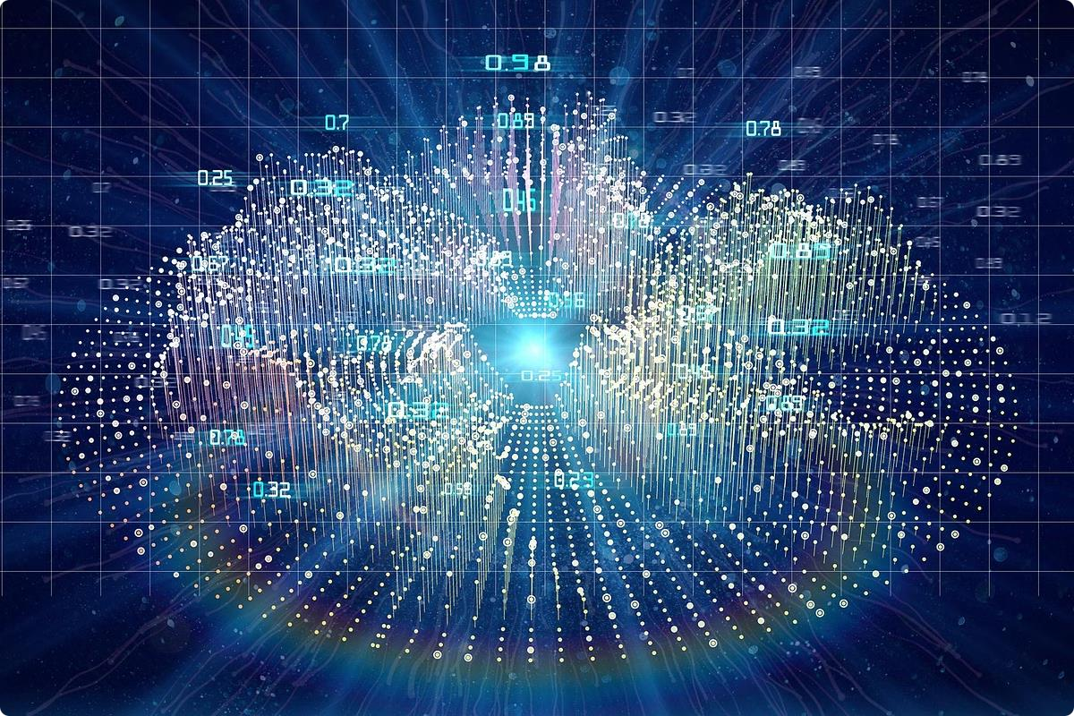
Quantum Algorithms and their Advantages
Shor's Algorithm
Quantum computers can efficiently factor large numbers, threatening the security of many existing cryptographic systems.
Grover's Algorithm
Quantum computers can search unstructured databases quadratically faster than classical computers.
Quantum Simulations
Quantum computers are well- suited to simulate quantum mechanical systems, with applications in chemistry, materials science, and beyond.
Quantum Annealing
Specialized quantum computers can efficiently solve certain optimization problems, like finding the global minimum of a function.

Slide 7

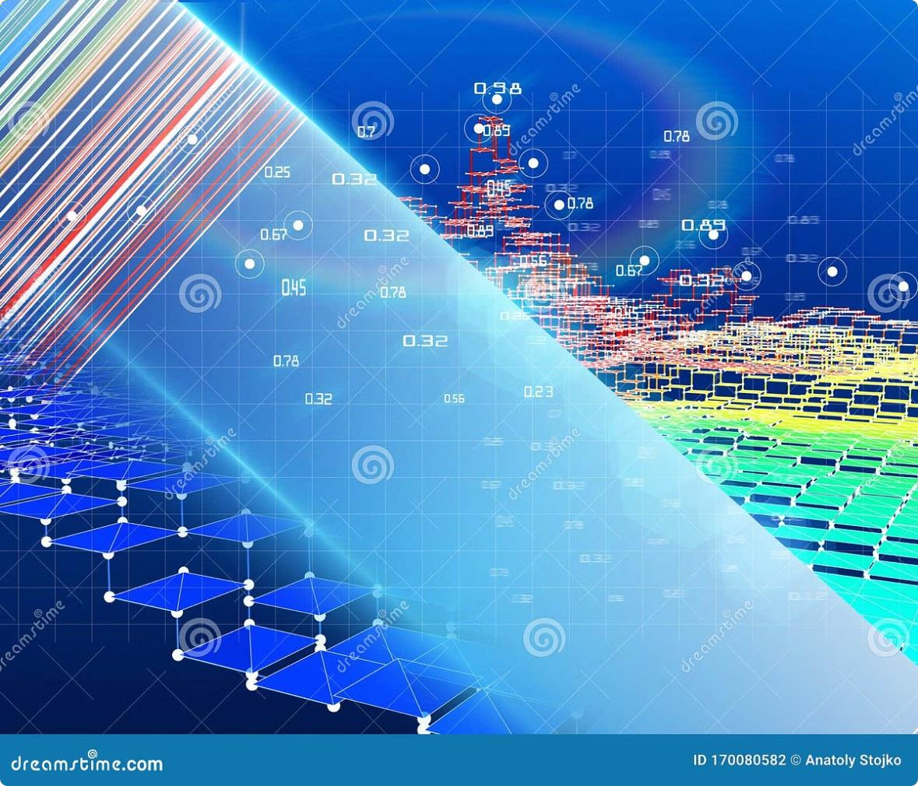
Quantum Cryptography and Cybersecurity
1
Quantum Key Distribution
Quantum cryptography uses the laws of quantum physics to distribute encryption keys securely, protecting against eavesdropping.
2
Post-Quantum Cryptography
New cryptographic algorithms are being developed to protect against the threat of quantum computers breaking current encryption schemes.
3
Quantum S upremacy
Once a quantum computer can perform a calculation faster than the world's best classical supercomputer, it will have achieved quantum supremacy.

Slide 8


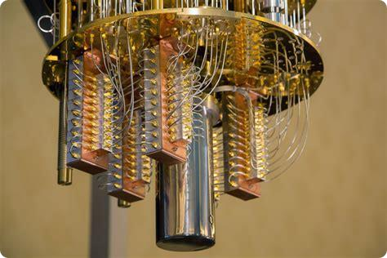


Current Quantum Computing Hardware
Superconducting Qubits
Manipulation of microwave-frequency superconducting circuits to create qubits.
Trapped Ion Qubits
Qubits encoded in the internal states of individual trapped atomic ions.
Photonic Qubits
Qubits encoded in the polarization or frequency of individual photons.
Spin Qubits
Qubits encoded in the spin states of electrons or nuclei in solid-state systems.

Slide 9


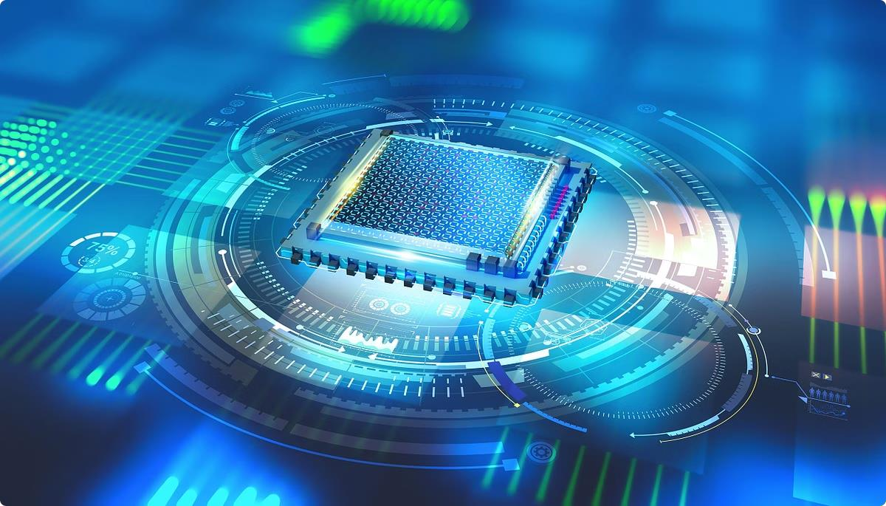
Challenges and Limitations of Quantum Computing
Decoherence
Quantum systems are highly fragile, and even slight interactions with the environment
can cause the loss of quantum information.
Scalability
Scaling up the number of reliable, high-fidelity qubits remains a significant technological
hurdle.
Error Correction
Quantum error correction techniques are necessary to protect against the inevitable
errors that occur in quantum computations.
Cost and Complexity
Quantum computers require specialized, expensive hardware and complex control
systems, limiting their accessibility.

Slide 10

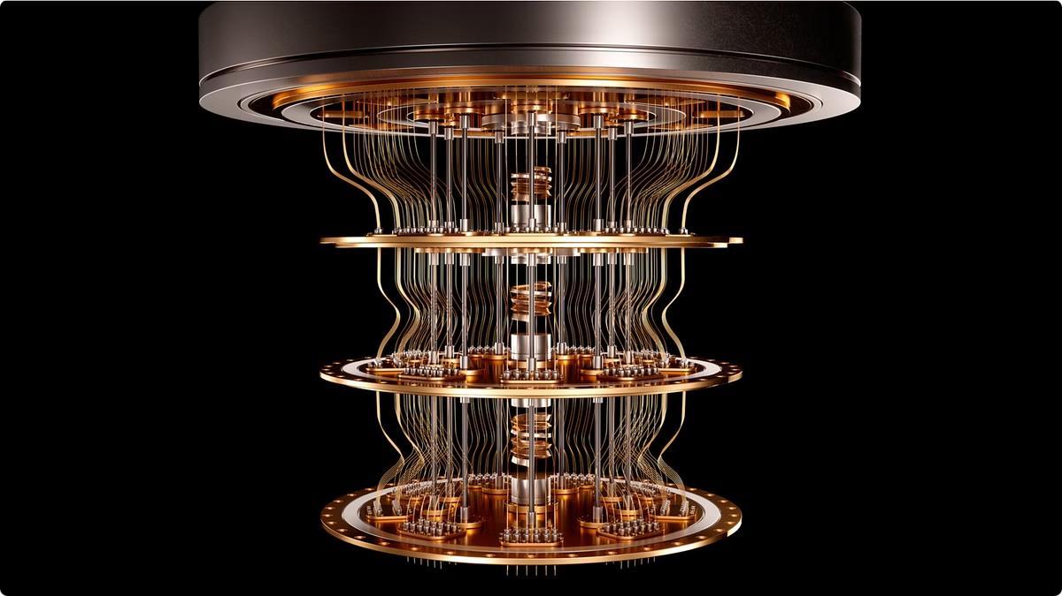
The Future of Quantum Computing
1
Near-Term Applications
Quantum computers are expected to provide advantages in areas like quantum chemistry, optimization, and cryptanalysis.
2
Quantum Internet
The development of a quantum internet, leveraging entanglement for secure communication, is a long-term goal.
3
Quantum Supremacy
Achieving quantum supremacy, where a quantum computer outperforms the world's best classical supercomputer, is a major milestone.
4
Practical Quantum Computing
The realization of large-scale, fault-tolerant quantum computers capable of solving real-world problems remains a long-term challenge.

Slide 11
THANK YOU

